Slide 1
Derived Logical Connectives And Examples

Slide 2
Example 1
Suppose we have two simple statements: P, Q
Form a compound statement using AND logical connectives and negate it
Answer: ~ (p ∧ q)
Suppose we have two simple statements: P, Q
Form a compound statement using AND logical connectives
Answer: p ∧ q
p
F
F
T
T
q
F
T
F
T
p ∧ q
F
F
F
T
p
F
F
T
T
q
F
T
F
T
p ∧ q
F
F
F
T
~(p ∧ q)
F
F
F
T

Slide 3
Example 2
Suppose we have two simple statements: P, Q
Form a compound statement using OR logical connectives and negate it
Answer: ~ (p ∨ q)
Suppose we have two simple statements: P, Q
Form a compound statement using OR logical connectives
Answer: p ∨ q
p
F
F
T
T
q
F
T
F
T
p ∨ q
F
T
T
T
p
F
F
T
T
q
F
T
F
T
p ∨ q
F
T
T
T
~(p ∨ q)
T
F
F
F

Slide 4
NAND (Not And)
It means negation after AND operation of two statements. Assume p and q be two propositions. The NAND operation of p and q to be a proposition which is false when both p and q are true, otherwise true. It is denoted by p ↑ q.
p | q | p ↑ q
T | T | F
T | F | T
F | T | T
F | F | T

Slide 5
NOR (Not OR)
It means negation after OR operation of two statements. Assume p and q be two propositions. The NOR operation of p and q to be a proposition which is true when both p and q are false, otherwise false. It is denoted by p ↓ q. It is also know as the Joint Denial.
p | q | p ↓ q
T | T | F
T | F | F
F | T | F
F | F | T

Slide 6
XOR (Exclusive OR)
Assume p and q be two propositions. The XOR operation of p and q is true if p is true or q is true but not both and vice-versa. It is denoted by p ⨁ q.
p | q | p ⨁ q
T | T | F
T | F | T
F | T | T
F | F | F

Slide 7
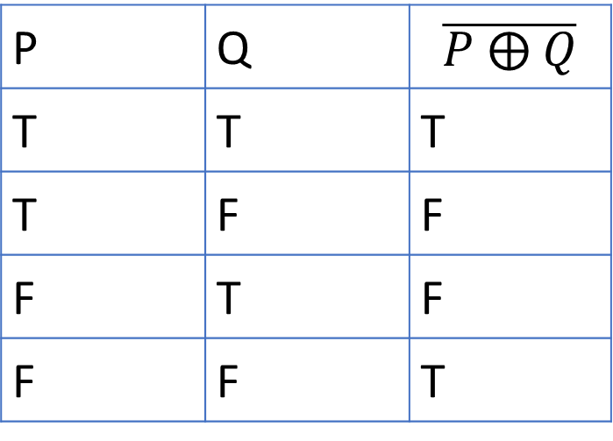
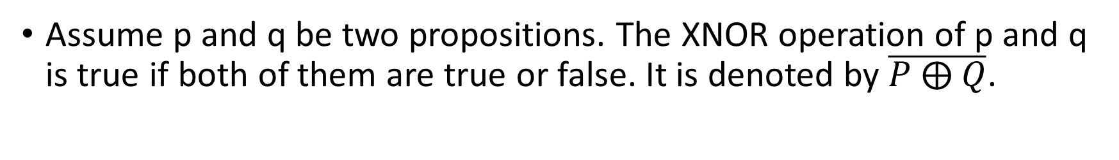
XNOR (Exclusive Not OR)
Assume p and q be two propositions. The XNOR operation of p and q is true if both of them are true or false. It is denoted by $\overline{P ⨁ Q}$.
P | Q | $$\overline{P ⨁ Q}$$
T | T | T
T | F | F
F | T | F
F | F | T

Slide 8
Example 3: Prove that X ⨁ Y ≅ (X ∧∼Y)∨(∼X∧Y)
X
T
T
F
F
Y
T
F
T
F
X⨁Y
F
T
T
F
∼Y
F
T
F
T
∼X
F
F
T
T
X ∧∼Y
F
T
F
F
∼X∧Y
F
F
T
F
(X ∧∼Y)∨(∼X∧Y)
F
T
T
F
As the truth table for both the proposition is the same X ⨁ Y ≅ (X ∧∼Y)∨(∼X∧Y). Hence Proved.

Slide 9
Example 4: Prove that (P ⨁ Q) ∨ (P ↓ Q) is equivalent to P ↑ Q
P
T
T
F
F
Q
T
F
T
F
P⨁Q
F
T
T
F
P ↓ Q
F
F
F
T
P ↑ Q
F
T
T
T
(P ⨁ Q) ∨ (P ↓ Q)
F
T
T
T
As the truth table for both the proposition are the same, (P ⨁ Q) ∨ (P ↓ Q) is equivalent to P ↑ Q [Proved]

Slide 10
Variations in Conditional Statement
Contrapositive: The proposition ~q→~p is called contrapositive of p →q.
Converse: The proposition q→p is called the converse of p →q.
Inverse: The proposition ~p→~q is called the inverse of p →q.

Slide 11
Example 5: Show that P → Q and its contrapositive ~Q→~P are logically equivalent
P
T
T
F
F
Q
T
F
T
F
∼P
F
F
T
T
∼Q
F
T
F
T
P → Q
T
F
T
T
~Q→~P
T
F
T
T
As the truth table for both the proposition are the same, P → Q and its contrapositive ~Q→~P are logically equivalent [Showed]

Slide 12
Example 6: Show that proposition Q→P, and ~P→~Q are not equivalent to P→Q.
P
T
T
F
F
Q
T
F
T
F
∼P
F
F
T
T
∼Q
F
T
F
T
P → Q
T
F
T
T
~P→~Q
T
T
F
T
Q→P
T
T
F
T
(Q→P) ∧ ~P→~Q
T
T
F
T
As the truth table for both the proposition are not the same, q→p, and ~p→~q are not equivalent to p →q[Showed]

Slide 13
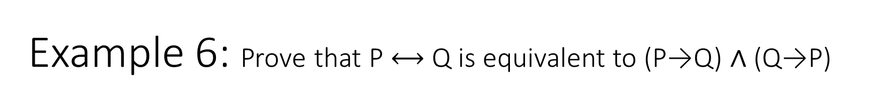
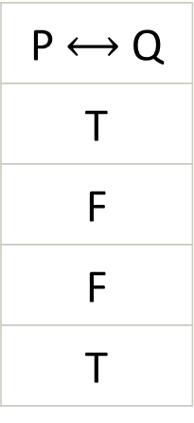
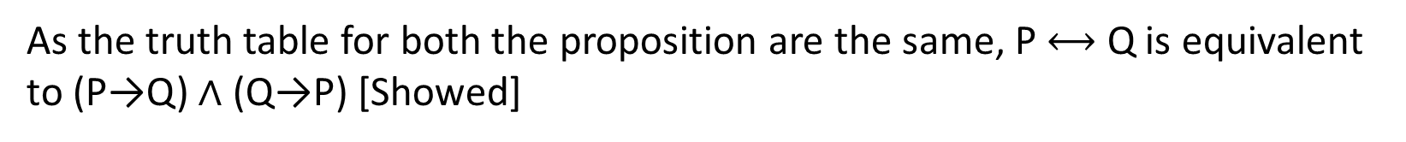
Example 6: Prove that P $⟷$ Q is equivalent to (P→Q) ∧ (Q→P)
P
T
T
F
F
Q
T
F
T
F
P → Q
T
F
T
T
Q→P
T
T
F
T
(P→Q) ∧ (Q→P)
T
F
F
T
P $⟷$ Q
T
F
F
T
As the truth table for both the proposition are the same, P $⟷$ Q is equivalent to (P→Q) ∧ (Q→P) [Showed]

Slide 14
Example 6: Find the truth table of ~P∨Q.
P
T
T
F
F
Q
T
F
T
F
~P
F
F
T
T
~P∨Q
T
F
T
T

